Slide 1
HOUSE PRICE PREDICATION USING MACHINE LEARNING
Name:N.Mahesh
Course: Data scientist

Slide 2

INTRODUCTION
->Project Objective
->Tools& Technologies Used
->Problem Statement
->Data Description
-> Data Preprocessing
->Data Visualization
->Model Used
->Train test –Split
->Results and Prediction
->Conclusion

Slide 3
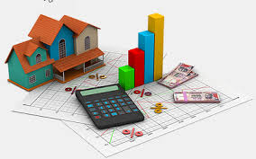
PROJECT OBJECTIVE
House price prediction helps buyers and sellers estimate property value.
It uses historical data and machine learning algorithms.
The model analyzes features like area, bedrooms, location, and age.
This project aims to build a model that predicts house prices accurately

Slide 4




TOOLS &TECHNOLOGY USED
In this project,I used the Python programming language along with libraries like Pandas, Numpy, Scikit-learn, and Matplotlib.
The main objective of this project is to predict house prices based on different features such as area, number of bedrooms, location and age of the house.
This project helps in understanding how machine learning models can be used to analyze real estate data and make accurate price predication

Slide 5
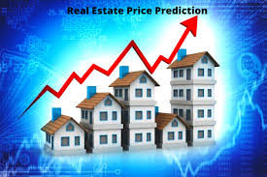
.
PROBLEM STATEMENT
Real estate prices vary based on many factors.
It is difficult to estimate the correct price manually.
The goal is to create a model that predicts house prices using data

Slide 6
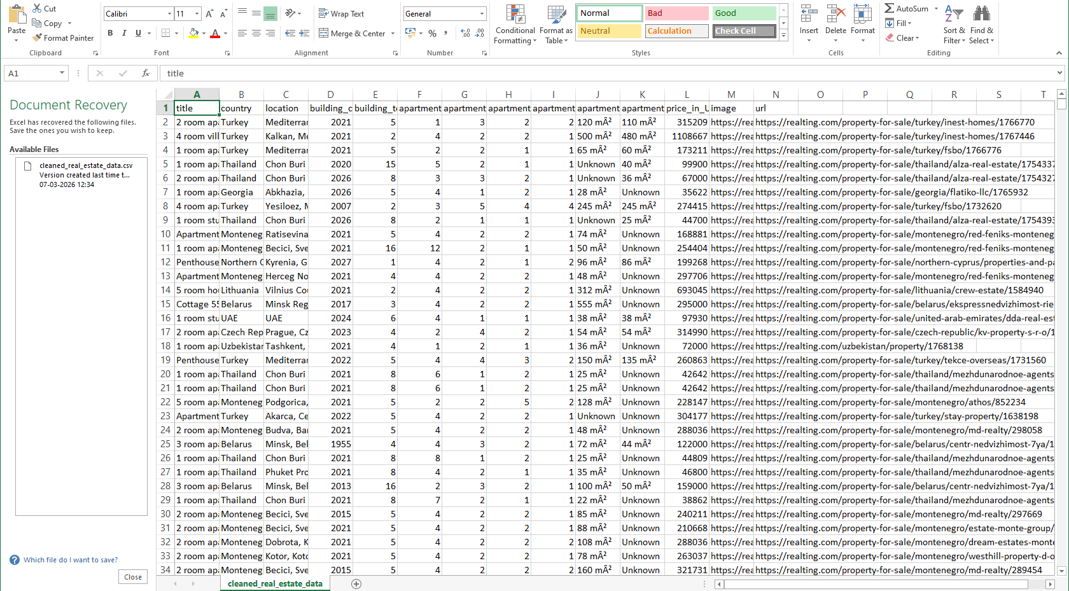
DATA DESCRIPTION
The data contains information about houses
Important features include:
Area (square feet)
Number of bedrooms
Location
Age of the property
Target variable: House Price

Slide 7

DATA PREPROCESSING
Removed duplicate values from the dataset.
Handled missing values.
Converted categorical data if required.
Prepared clean data for model training

Slide 8
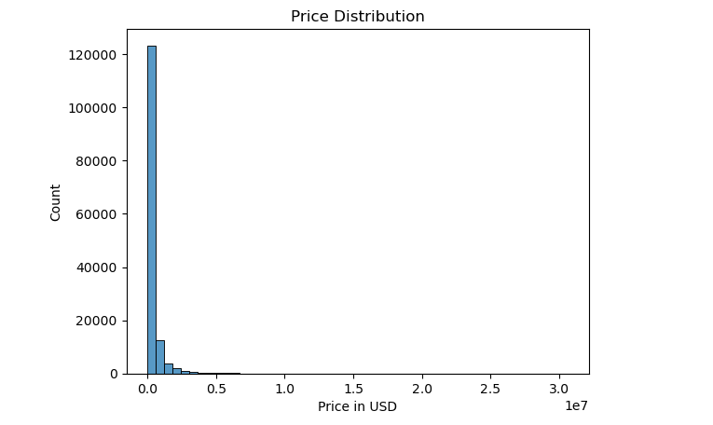
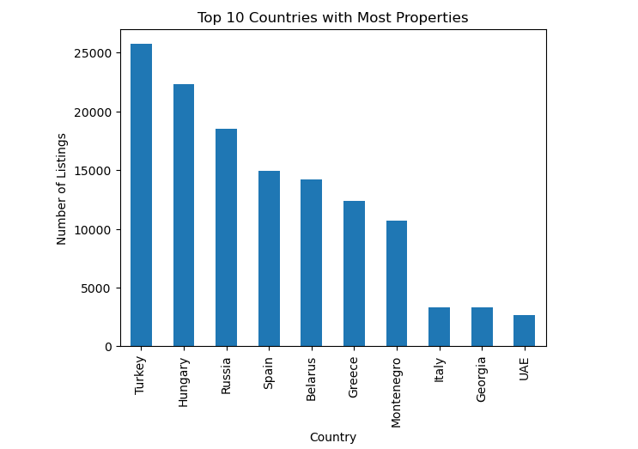
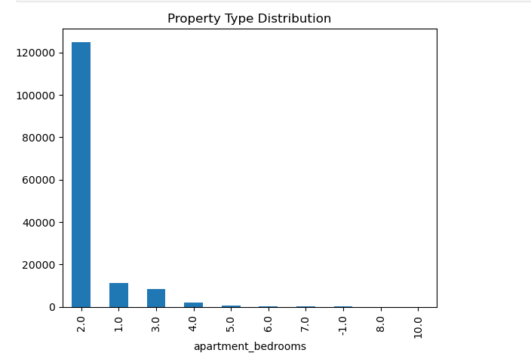
DATA VISUALIZATION
Visualized data using graphs.
Used histograms and bar charts to understand price distribution.
Observed the relationship between house features and price.

Slide 9
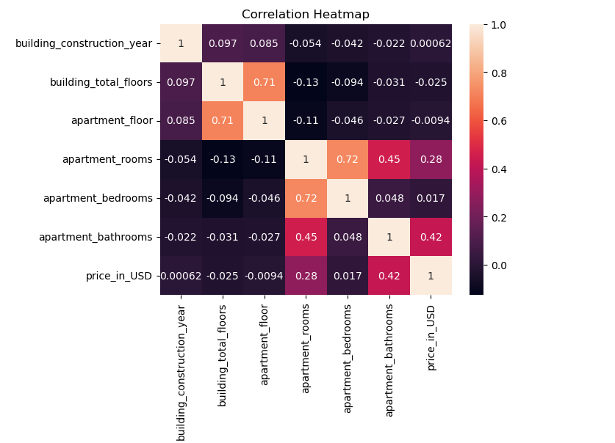
MODULE USED
Used Linear Regression algorithm.
It predicts values based on the relationship between variables.
The model learns patterns from historical data.

Slide 10
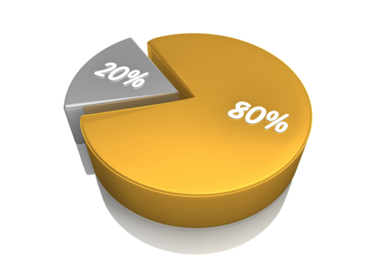

TRAIN TEST-SPLIT
The dataset was divided into two parts:
Training Data (80%) – Used to train the model.
Testing Data (20%) – Used to evaluate the model.
This helps measure the model’s performance.

Slide 11
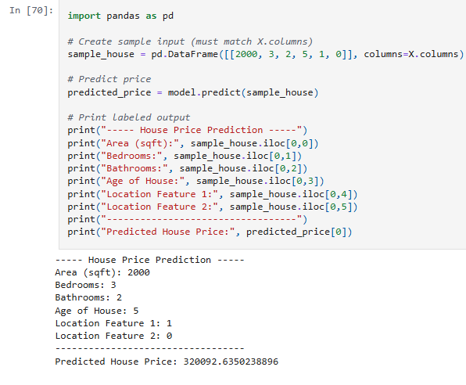
RESULT AND PREDICATION
The trained model predicts house prices based on input features.
Model performance was evaluated using testing data.
The results show that the model can estimate house prices reasonably well.

Slide 12
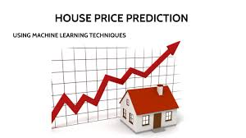
CONCLUSION
Built a machine learning model for house price prediction.
Used Python and Linear Regression for analysis.
The model helps estimate property prices efficiently.
In future, more features and advanced algorithms can improve accuracy.

